Slide 1
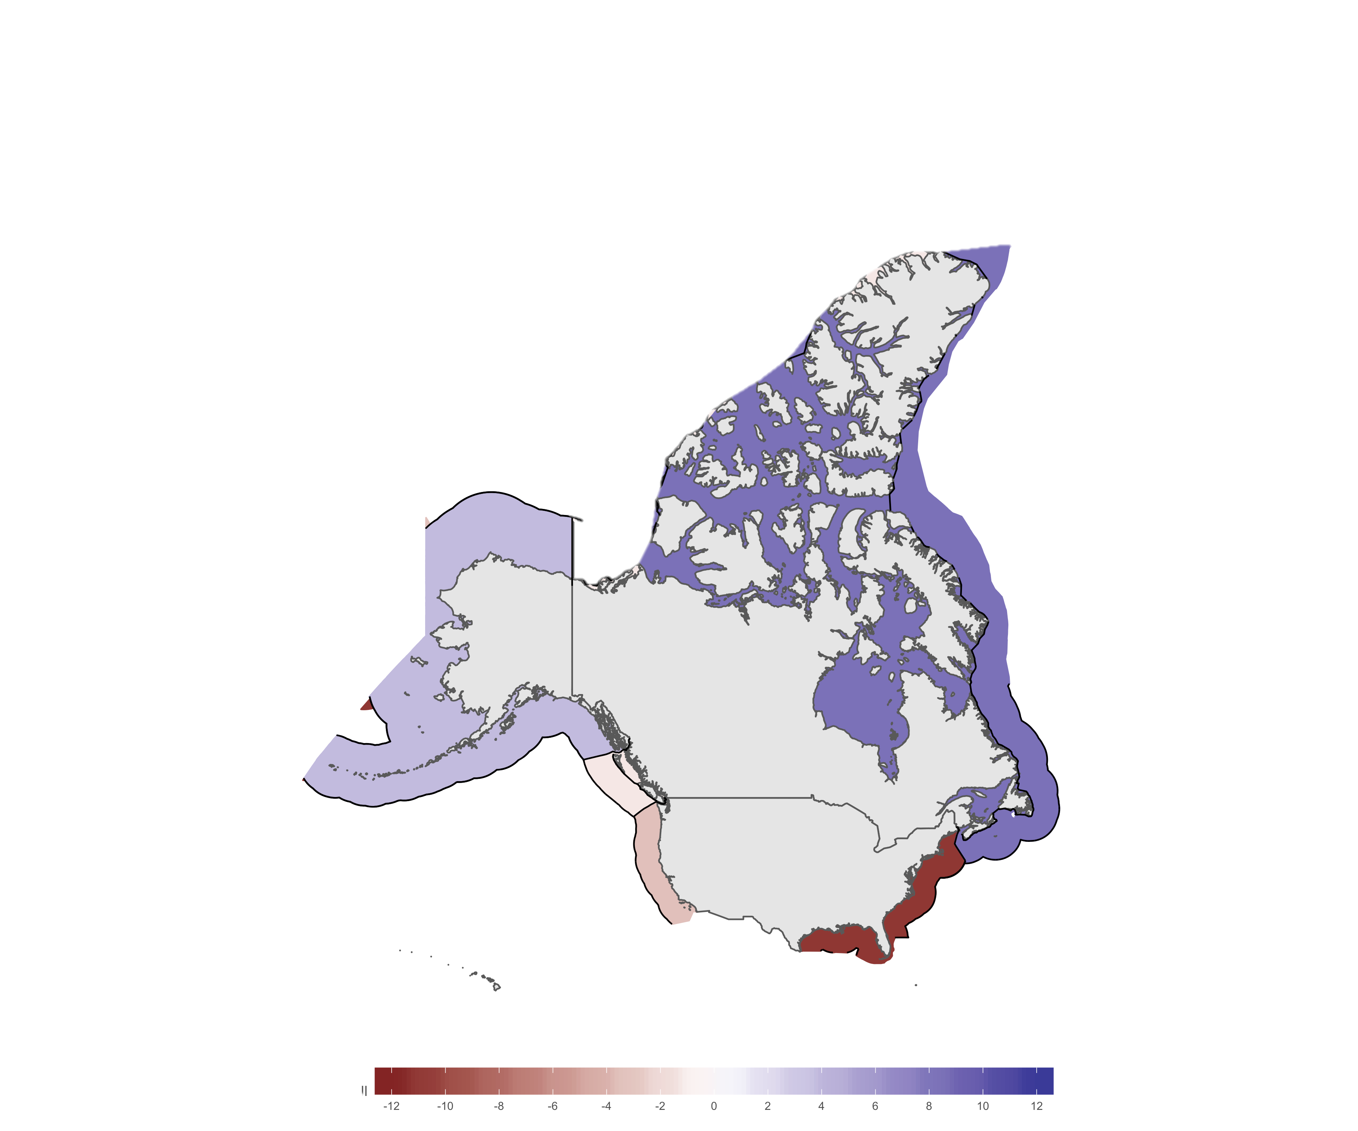
Increase potential catch share
Decrease potential catch share
Witch flounder
Glyptocephalus cynoglossus
Atlantic Cod
Gadus morhua
Pacific halibut
Hippoglossus stenolepis
Capelin
Mallotus villosus
North Pacific hake
Merluccius productus
Greenand halibut
Americn plaice

Slide 2
Increase potential catch share
Decrease potential catch share
Pacific halibut
Hippoglossus stenolepis
North Pacific hake
Merluccius productus
Atlantic Cod
Gadus morhua
Witch flounder
Glyptocephalus cynoglossus
Capelin
Mallotus villosus
Greenand halibut
Americn plaice

Slide 3
Increase in potential catch share
Decrease in potential catch share
Change in potential catch share
Pacific halibut
Hippoglossus stenolepis
North Pacific hake
Merluccius productus
Atlantic Cod
Gadus morhua
Witch flounder
Glyptocephalus cynoglossus
Capelin
Mallotus villosus
Greenand halibut
Americn plaice

Slide 4
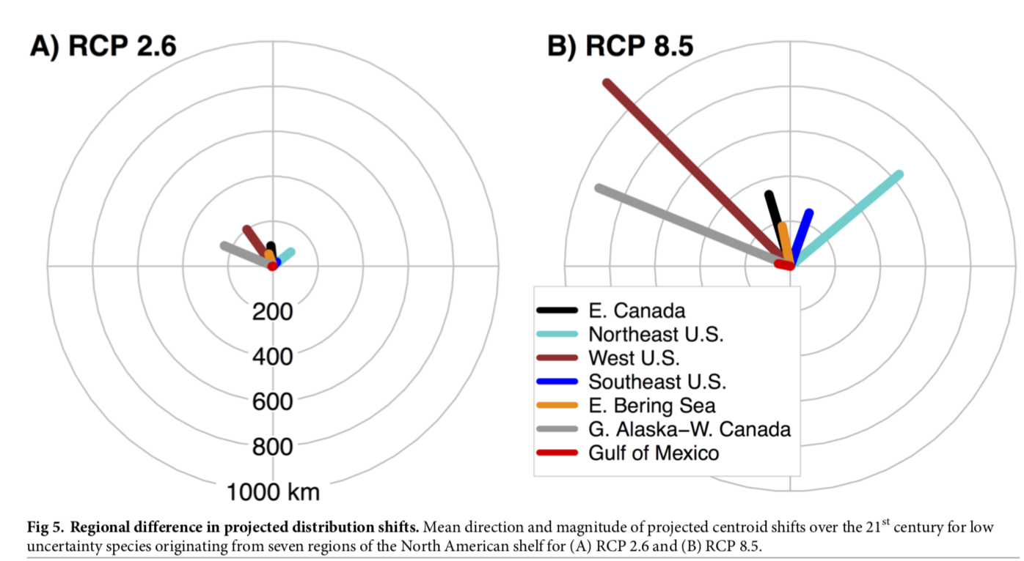
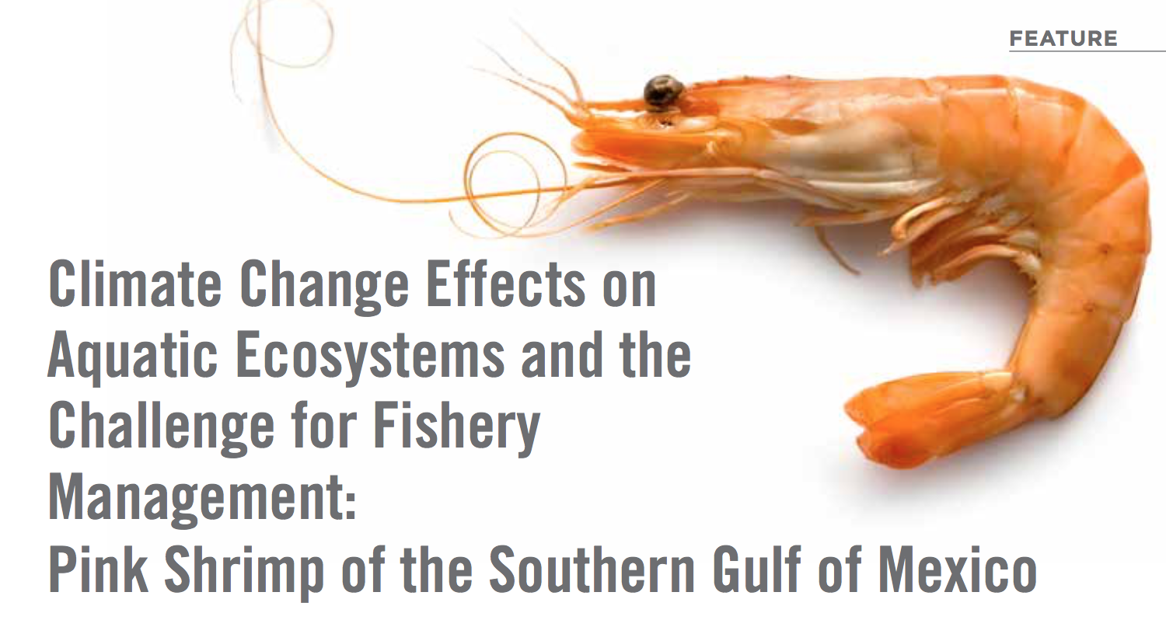
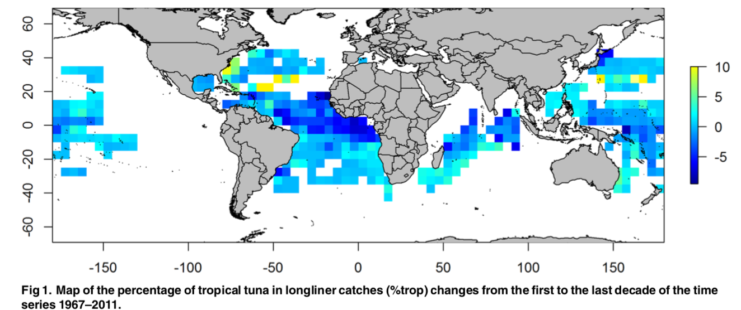
North America as a case study
Climate Change
Transboundary fisheries
Game theory
Objective and Framework
Chapter 1
Chapter 2
Chapter 3
Chapter 4
Summary
References
Oceanographic conditions:
Species distribution shifts:
Temperature change (1982 -2006):
Gulf Alaska: 0.30 - 0.60 °C
US Pacific: 0 - -0.10 °C
US Atlantic: 0 - 0.2 °C
Canada Atlantic: 0.96 - 1.35 °C
O₂ change since 1960:
Atlantic: -9 ± 19 tmol /Dec
Pacific: -173 ± 40 tmol /Dec
pH will change relative to 1865:
North Amercia: -0.15 – -0.31 units
Arreguín-Sánchez et al 2015 | Fish
Monllor-Hurtado et al 2017 | Plos
Morley et al 2018 | Plos
Belkin 2009| Prog Osceanogr.; Schmidtko et al 2017| Nature; Feely et al 2009 | Oceanography

Slide 5

Main Question
What will be the effects of shifting species to the co-management of transboundary fisheries?
EEZ A
Transboundary Stock
Coastal
State A
Straddling Stock
HIGH SEAS
Discrete High Seas Stock
Coastal
State B
Non-Transboundary Stock
EEZ B
Notes:
The main objective of my doctoral research is to understand the implications of climate change for transboundary fish stocks. More specifically, I am interested in the consequences of shifting distributions for fisheries management. Hence, my thesis will explore the impacts of climate change on current transboundary fisheries of Canada, Mexico, and the United States and will explore the possibility of using lessons learned from this as examples to manage potential emerging shared stocks between Mexico and United States. With my research, I intend to contribute to the overall knowledge of shifting stocks in North America as well as improve fisheries management and policy for Mexico, Canada, and the United States.

Slide 6
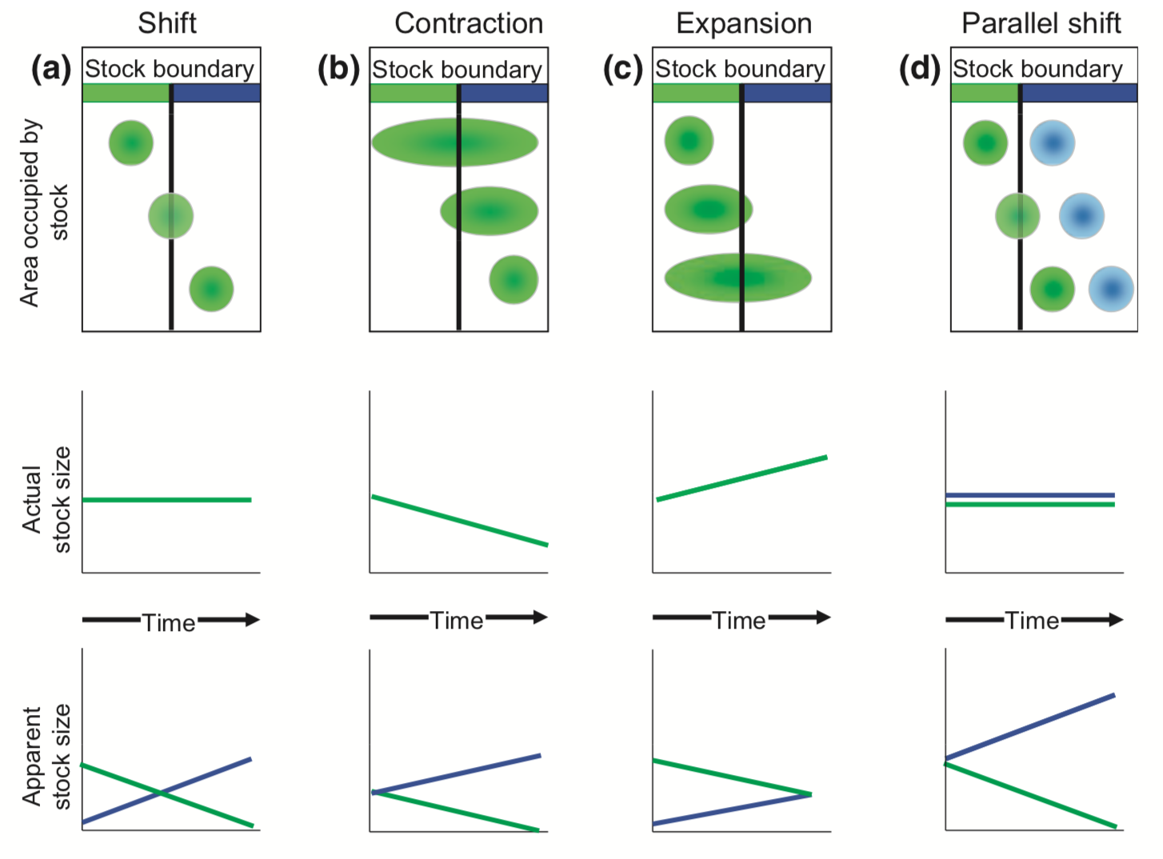
Understand the implications of climate change for the management of transboundary fish stocks
Climate Change
Transboundary fisheries
Game theory
Objective and Framework
Chapter 1
Chapter 2
Chapter 3
Chapter 4
Summary
References
Different types of species shift
Different management status
“Discreet” stocks today
Already co-managed
Already transboundary no-comanaged
These will all have consequences for fisheries management compromising the sustainability of shared (and non shared) stocks
Link et al 2010 | Fish Fish

Slide 7
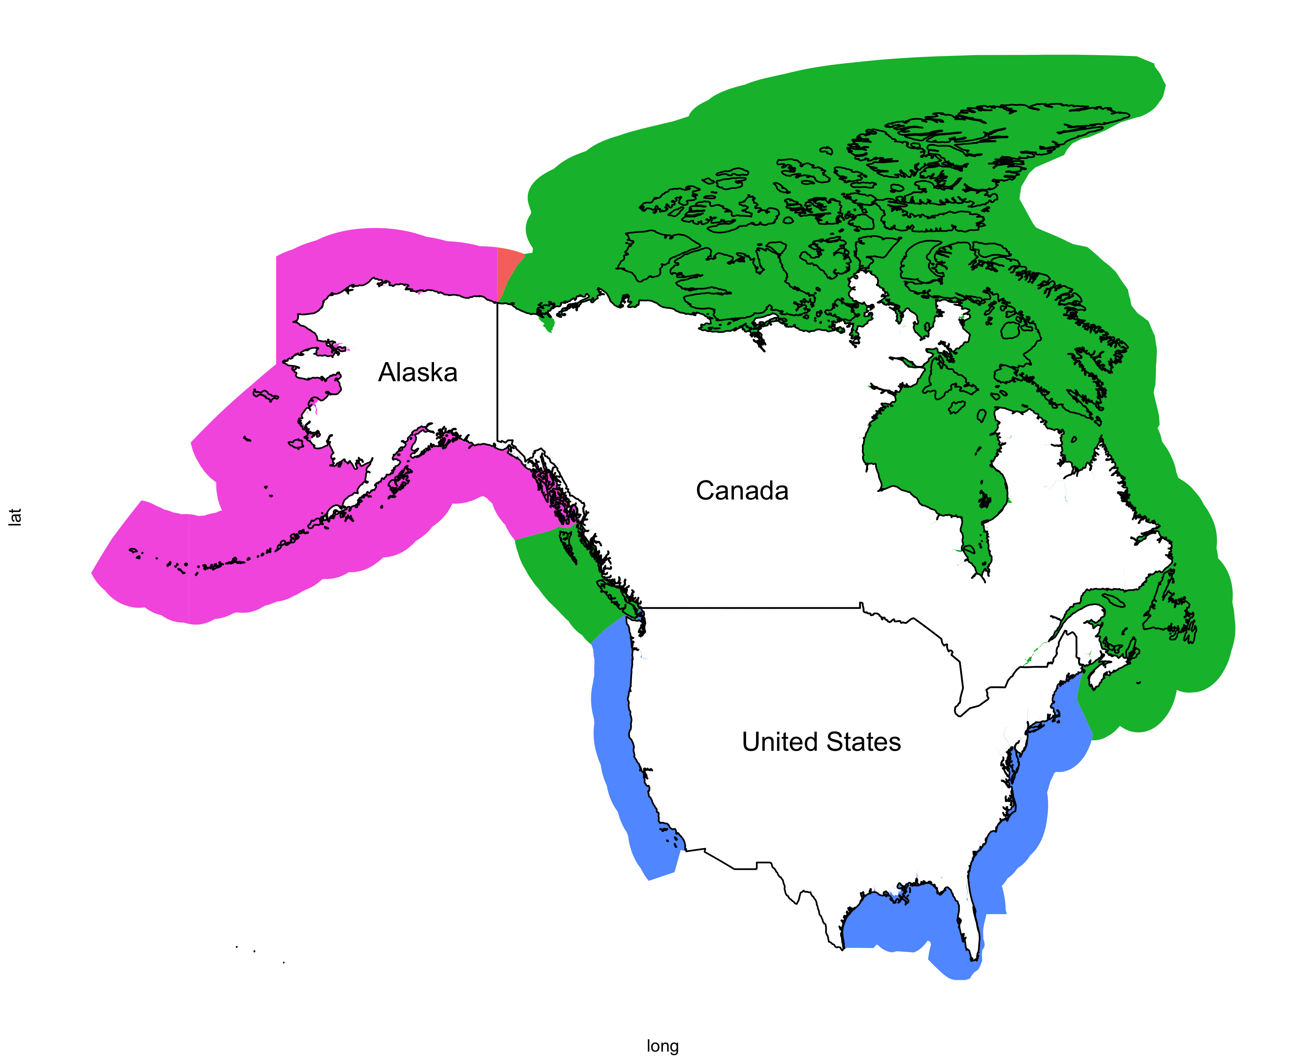
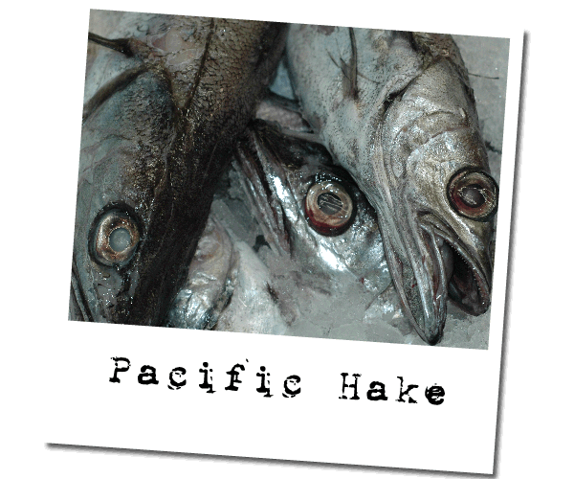
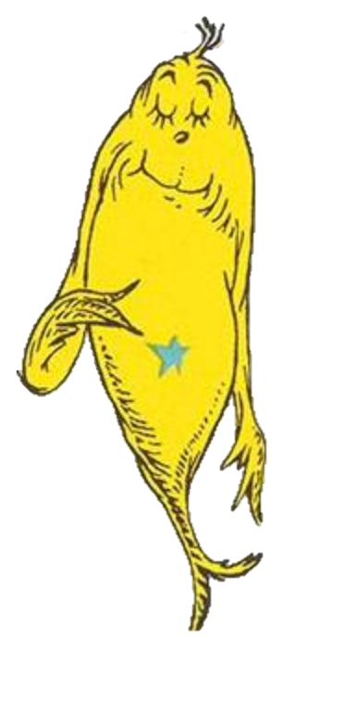
Methods | Treaties Under the Spotlight
Spp. = 1
NAFO
Spp. = 11*
Spp. = 5
Gulf of Maine “gentlemen's” Agreement (CIA, 2012)
Spp. = 3
Spp. = 2
Total Spp. = 31
Notes:
Pacific Hake = 1 Spp
NAFO = 17 Spp

Slide 8
Implications for management will depend on the management plans themselves
Species considered
Climate change considerations
“Legal strength”
Management rules *
Covering range
Regional trade-offs
Conservation (Closed area)
Social consequences (fishers benefitting in different regions)
Bycatch quota might be affected by overlapping species

